Slide 1


The
SOCIAL BUZZ
Journey

Slide 2


Today's agenda
Project recap
Problem
The Analytics team
Process
Insights
Summary

Slide 3

Title: Data Analytics Project Recap
Subtitle: Analyzing Top Categories for Social Buzz
Presented by: Aloys Alfred
Role: Data Analyst at Accenture
Client: Social Buzz
Industry: Social Media & Content Creation
Objective:
Audit big data practices
Recommendations for a successful IPO
Analysis of content categories to highlight the top 5 categories with the largest aggregate popularity
Data Sets Provided
Total Data Sets: 7
Key Tables for Analysis:
Content Table
Reactions Table
Reaction Types Table
Project Recap

Slide 4


Problem
Scaling Challenges:
Over the past 5 years, Social Buzz has reached over 500 million active users each month.
Data Management Issues:
Due to their rapid growth and digital nature, the amount of data they create, collect, and must analyze is huge.
Despite a large technical team, they lack the resources to manage the current scale of their operations efficiently.
IPO Preparation:
They are looking to complete an IPO by the end of next year and need guidance to ensure this process goes smoothly.
Best Practices and Expertise:
Due to the nature of their business, they have a massive amount of data, and they are keen on identifying weak spots and improving their technology infrastructure.

Slide 5

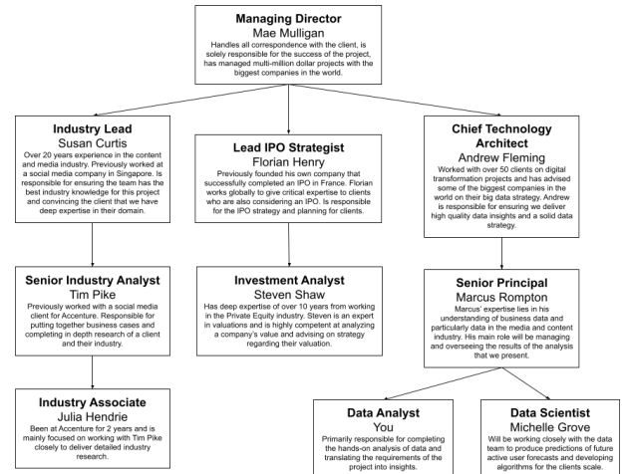


The Analytics team

Slide 6
Process
1
Initial Analysis and Understanding:
Reviewed the client brief and identified key objectives and requirements.
Assessed the provided data sets and identified relevant tables for analysis.
2
Data Cleaning and Preparation:
Removed unnecessary columns and standardized data formats.
Ensured data consistency and resolved any discrepancies in the datasets.
Merging Data Sets:
Used VLOOKUP and other merging techniques to combine the Content, Reactions, and Reaction Types tables.
Ensured accurate joining of tables based on Content ID and Type.
3
4
Data Analysis:
Grouped the merged dataset by Category.
Calculated total scores for each category using the SUMIF formula.
Sorted categories based on total scores to identify the top 5 performing categories.
5
Visualization and Insights:
Created visual representations of the data to highlight key findings.
Identified top-performing content categories: Animals, Healthy Eating,
Technology, Science, and Culture.

Slide 7

Insights
High Engagement Categories:
Animals: The highest engagement category with a total score of 71,242. Content related to animals drives significant user interaction Healthy Eating: Second highest with a score of 69,067. Health and wellness content is very popular among users.
Technology: A close third with a score of 68,521. Technology-related content attracts a large audience.
Science: With a score of 66,549, science content is also highly engaging.
Culture: Rounding out the top 5 with a score of 64,952, cultural topics are very popular.
Content Strategy:
Focus on Top Categories: Creating and promoting more content in the top-performing categories (Animals, Healthy Eating, Technology, Science, and Culture) can drive higher engagement and user interaction.
Audience Preferences:
Users show a clear preference for content related to animals, health, and technology, indicating these areas should be prioritized in content planning and development.

Slide 8
Data-Driven Decision Making:
Regular analysis of content performance can help identify emerging trends and shifts in user preferences, allowing Social Buzz to stay ahead of the curve.
Implementing a feedback loop where user engagement data informs content strategy will ensure relevance and engagement.
Scalability and Efficiency:
With the upcoming IPO, demonstrating data-driven strategies and high user engagement in key content areas can be a strong selling point to investors.
Streamlining content creation around high-performing categories can improve operational efficiency and resource allocation.
Technological Infrastructure:
The need for sophisticated data management and analysis tools is highlighted by the large volumes of unstructured data.
Investing in advanced analytics and AI-driven insights can further enhance the ability to personalize content and improve user experience.
Preparation for IPO:
Highlighting the strengths in content engagement and demonstrating a solid, data-backed growth strategy will be crucial for the IPO process.
Ensuring that the technology infrastructure can handle future growth and increased data volumes will be essential.
By focusing on these insights, Social Buzz can optimize their content strategy, improve user engagement, and better prepare for their IPO, leveraging data-driven decisions to ensure continued growth and success.

Slide 9

The project aimed to enhance Social Buzz's big data practices, prepare for their IPO, and analyse their content categories to determine the top 5 performing ones. To achieve this, we conducted a comprehensive data analysis using the provided datasets.
Key Steps in the Project:
1.Data Cleaning
2.Data Merging
3.Data Analysis
Findings:
The top 5 categories with the highest engagement were:
1. Animals
2. Healthy Eating
3. Technology
4. Science
5. Culture
Insights and Recommendations
Content Strategy
Marketing
Data-Driven Decisions
Technological Investment
IPO Preparation
By implementing these recommendations, Social Buzz can optimize their content strategy, improve user engagement, and better prepare for their IPO, ensuring sustained growth and success.
Summary

Slide 10

Thank you!
ANY QUESTIONS?

